Slide 1

Classification of COVID patients using neural networks
Jayshil Patel (18EC068)
Josh Patel(18EC070)
Shubham Barve(18EC007)

Slide 2
Need for an alternative
Time consumption
Average cost
Availability
Accuracy

Slide 3
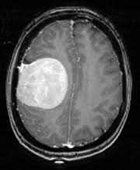
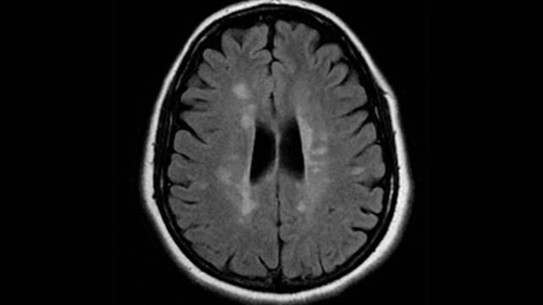
Any guess which of the following is Covid positive patient’s chest x-ray?

Slide 4
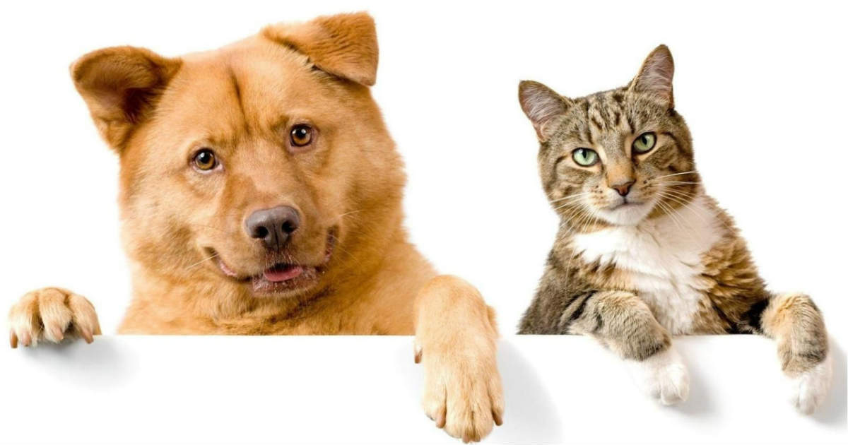
How do we distinguish between cat and dog?

Slide 5
How can we search through an image for special features?
[1,3,5,7,8,9]
How can we search for a particular number ?

Slide 6
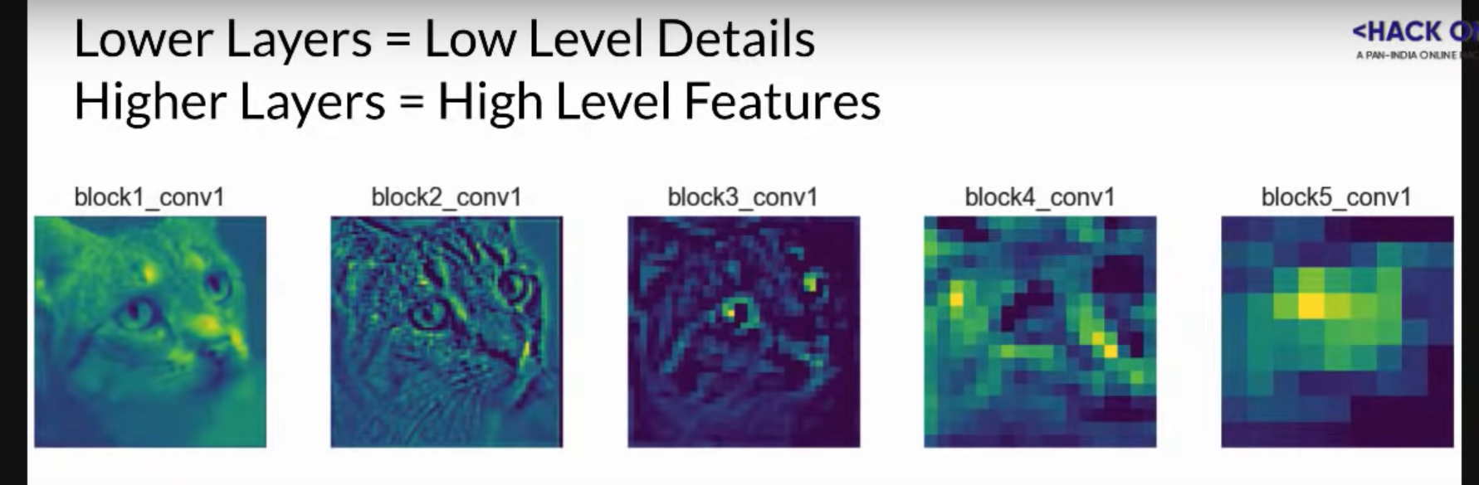
What are layers in the neural network?

Slide 7
Example of convolution

Slide 8
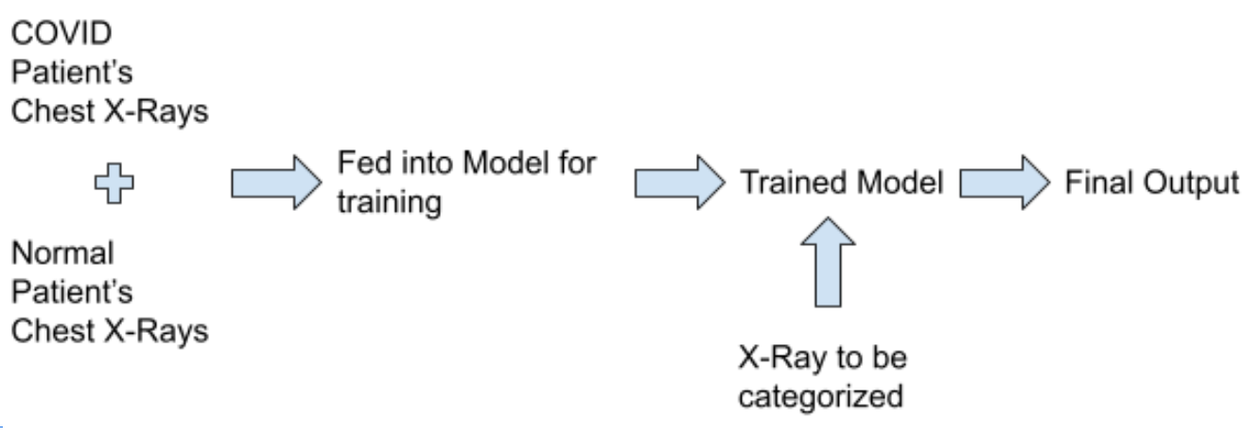
Classification of COVID patients involves various steps namely :-

Slide 9
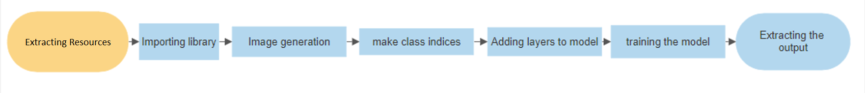
Software flow diagram

Slide 10
Reason for choosing google collab
Readily available libraries like tensorflow and keras
Platform independent
Only browser required
No prior installation required

Slide 11
Gathering resources
Number of images and accuracy
Correct incides
Authenticity of resources
Dorsal or ventral view

Slide 12
Why to choose Python over MATLAB?
Wider availability of resources
Better help and bigger community
Better packages
Availability of google collab
Hence, platform independent

